Slide 1

Welcome!
Information For Organisations Looking To Become A Referral Agency

Slide 2

This presentation will:
Introduce you to the Foodbank, its staff, clients and supporters
Describe the role and responsibilities of referral agencies and individual voucher issuers
Help you decide if becoming a referral agency is for you
Provide you with information on how to apply

Slide 3

About our Foodbank
Cardiff Foodbank was founded in 2009. We are a registered charity and part of the Trussell Trust Network of Foodbanks. We are one of approximately 39 Foodbanks in Wales and 427 Foodbanks across the UK.
Other local foodbanks cover the Vale of Glamorgan, Newport, Caerphilly and the Valleys.
Foodbanks provide three days’ nutritionally-balanced emergency food to people who are experiencing a crisis causing food poverty, as well as support to help people resolve the challenges they’re facing.

Slide 4

About our Foodbank
Our clients are people who, through a wide range of circumstances including illness, benefit delays, an unexpected bill, or just insufficient income, find themselves with no money for food.

Slide 5
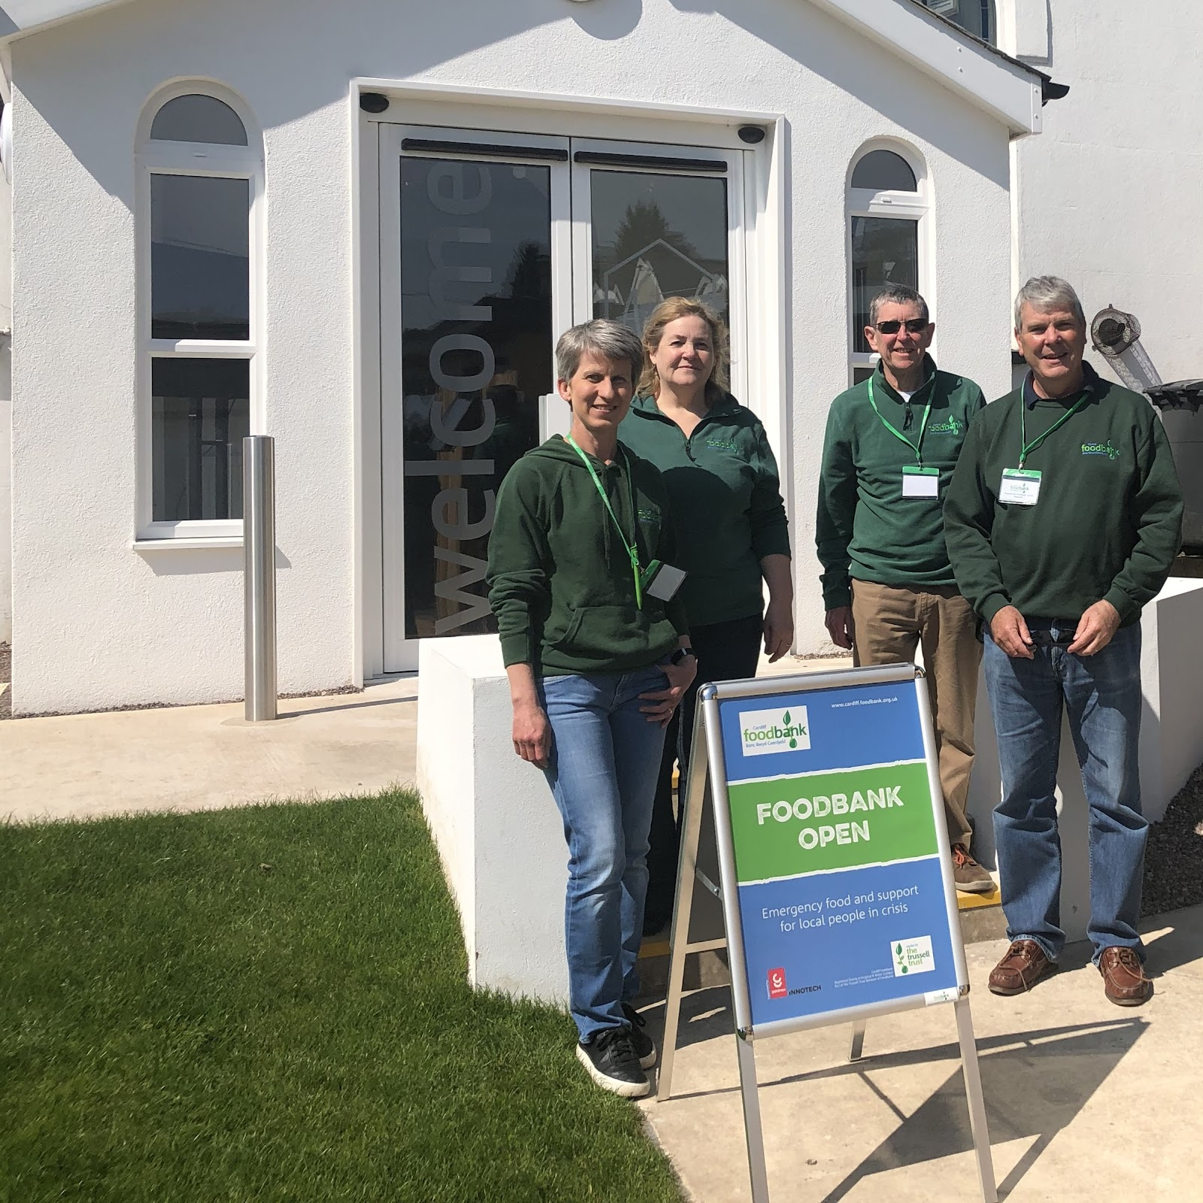
About our Foodbank
We operate via a central warehouse and offices in Cardiff Bay, plus eight Distribution Centres across Cardiff:
CATHAYS
CENTRAL
ELY
GRANGETOWN
LLANEDEYRN
SPLOTT
ST. MELLONS
TONGWYNLAIS

Slide 6
About our Foodbank
MEET
OUR
STAFF
CEO – Rachel Biggs
Strategic Manager – Liz Davies
Operations Manager – Mark Tugwell
Operations Coordinator – Jodie Jay
Volunteer Coordinator – Sam Johnson
Warehouse Supervisor – David Eccles
Finance Officer – Terence Topham
Senior Administrator – Sara Redwood

Slide 7
About our Foodbank
OUR
VOLUNTEERS
We have over 200 volunteers, who:
pick up and deliver food
sort, date and shelve donated food and collate orders
run the distribution centres
provide administrative support
raise funds and organise food collections
staff supermarket food collections

Slide 8
About our Foodbank
OUR
PARTNERS
We also have many Partners who support us with:
Fundraising Events
Employee Volunteers
Food Collections
Business Advice
Finance

Slide 9

About our Foodbank
Cardiff Foodbank is a registered Charity
Our operating costs (e.g. warehouse rent, utilities, vans and staff salaries) are covered by donations and grants
We welcome donations and ideas for fundraising

Slide 10
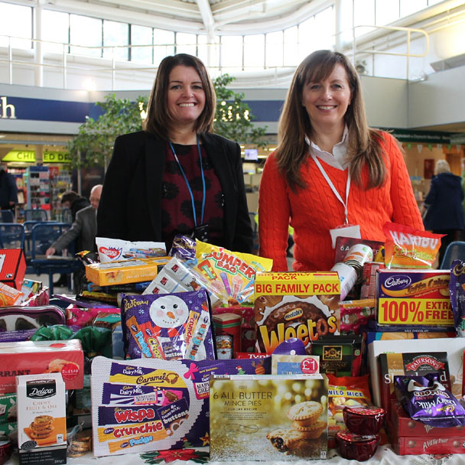
Non-perishable food is donated
How we operate
We depend entirely on food donated from churches, businesses, schools, individuals, or through supermarket collections. Our website advises on current needs. Currently we can only accept long-life, not fresh, food.

Slide 11
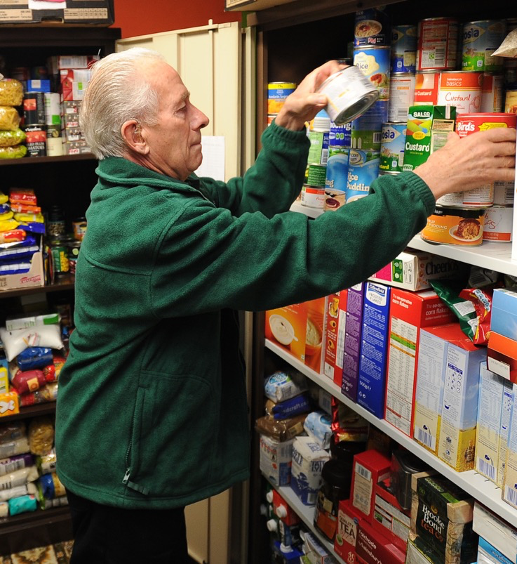
How we operate
Volunteers sort and
store the food
All food arriving at our central warehouse is weighed in and sorted by date, ready for sending out to our distribution centres

Slide 12

How we operate
Frontline professionals give foodbank vouchers to
people in crisis
We partner with 200+ care professionals and agencies - like health visitors, social workers, or Citizens Advice staff - who identify people in need and issue Foodbank vouchers.

Slide 13
Clients exchange their voucher for food at the Foodbank distribution centre
*Household is defined flexibly and includes anyone for whom the client is providing food in their place of residence. For example, one person may be supporting their children and their parents, or a sibling. For HMOs all residents/ families need to claim separately.
Clients take vouchers to a Foodbank centre where they are redeemed for 3 days’ emergency food for themselves and others in their household*.
The food allocated is nutritionally balanced, with dietary requirements and cooking facilities taken into account.

Slide 14
Foodbank staff take time to listen and signpost clients to further support
NOT JUST FOOD
Clients are also given the opportunity to:
have some refreshments and a chat
be offered a listening ear
be signposted to a range of other support services
receive advice from the Council’s Money Advice Team
access other relevant, helpful information and support
receive other items e.g. pet food, sanitary, household and baby products (not formula milk)

Slide 15
The Role of Voucher Issuers

Slide 16
Voucher Issuers
ASSESSING WHO QUALIFIES FOR FOODBANK VOUCHERS
One of our requirements for a referral agency is that the organisation (and person assessing the client) has the ability to recognise the client’s needs and root cause of their crisis, and to have the support available to either meet those needs and/or be able to signpost to an appropriate additional source of help.

Slide 17
Voucher Issuers
ASSESSING WHO QUALIFIES FOR FOODBANK VOUCHERS
The client is in a state of actual food poverty, with little or no food and insufficient funds to purchase enough food.
Their situation is the result of an identifiable, current crisis.
If the client’s circumstances (finances, number of dependents etc.) are not already known to the voucher issuer, they should make an assessment based on confirmatory evidence.

Slide 18
Voucher Issuers
ASSESSING WHO QUALIFIES FOR FOODBANK VOUCHERS
If more than 3 vouchers are needed, further assessment needs to be made to see what further support or help the client needs. This would be done in communication with Cardiff Foodbank. We are happy to support some clients over a longer period if there is nothing more they can do to improve their situation in the short term.
Part of the assessment process would also be looking at how to help the client plan how they get to the Distribution Centre to collect their food parcel. Also, to plan how they will get the food home. Volunteers will not give lifts to clients and we do not offer a delivery service at this time, but Bus Tickets may be available for the return journey from the Centre.

Slide 19
Voucher Issuers
REASONS FOR REQUIRING A FOOD VOUCHER - EXAMPLES
Client has no recourse to public funds (e.g. refugee/asylum seeker)
Benefit delay/changes
Debt
Significant disruption to earnings e.g. ill health
Unreliable income, loss of income or long-term insufficient income
Exceptional and unexpected bill
This is a list of examples, and is not meant to be exhaustive - we ask voucher issuers to put compassion before caution if they’re undecided.

Slide 20
Voucher Issuers
COMPLETE VOUCHERS CAREFULLY
Properly completed vouchers help to guard against fraud and duplication (e.g. Claire Jones and Clare Jones could be the same person but the different spelling will create a new record). They also ensure that the volunteers in the Distribution Centres have all the information they need to assist the client. It is important to make the experience of collecting the food as smooth and stress-free as possible.
Data Usage: the information is collated on the Trussell Trust’s UK database and can be used for lobbying to improve the situation of those in food poverty.

Slide 21

Voucher Issuers
The database helps us keep a track of how many vouchers people have had.
If we suspect that someone is misusing the voucher system we will inform you, and we request that you inform us if you become aware of or suspect any misuse.

Slide 22

Voucher Issuers
Each organisation will be given a Guidebook containing the key information and access to training. (Copies can be downloaded from the website)
The Named Manager for your organisation will be responsible for ensuring all new users are trained and they will need to keep the database up to date with any changes to the organisation, including members of staff who have left.

Slide 23
What happens next?
Once you have watched this presentation and you have decided that you would like to progress further, you will need to follow the link on the final page to access an online application form. Once we have received this we will contact you to arrange an informal meeting with you, either at you organisation’s base or in our main office.
If you have any questions at any time, please email us, or phone if you need an immediate response.

Slide 24



Follow/ Contact Us
Cardiff Foodbank,
Unit G, Cardiff Business Centre,
Titan Road,
Cardiff
CF24 5BS
info@cardiff.foodbank.org.uk
(monitored Monday – Thursday)
vouchers@cardiff.foodbank.org.uk
(monitored Monday and Thursday only – use for voucher related enquiries)
cardiff.foodbank.org.uk
trusselltrust.org
@Cardiff.Foodbank
@cardifffoodbank

Slide 25

Thank you for watching this presentation.
We look forward to working with you.
To apply to join us please follow this link
Or paste this link into your browser - https://forms.gle/MScPbo2VKreu4bkZA
If you are unable to open the form please email vouchers@cardiff.foodbank.org.uk

